Slide 1


ANALYSIS DASHBOARD
Team Members: Himanshu Kudesiya
Pravi Anand
Manish Sharma

Slide 2
CONTENT
Introduction
Project Objectives
Steps In Project
Key Performance Indicators
Performance Analysis
Real-Time Insights for Decision-Making
Conclusion

Slide 3
INTRODUCTION
Provide a brief introduction to Blinkit, emphasizing its role as a leading online grocery delivery platform.
State the core objective of the analysis: to offer actionable insights into customer behavior, sales performance, and operational efficiency.
Highlight the role of real-time analytics in enabling data-driven decision-making for improved customer satisfaction and business performance.
Mention the use of Power BI as a dynamic tool for dashboard creation and analysis.

Slide 4
Project Objectives
Identify and analyze patterns to optimize marketing and service strategies.
Evaluate sales performance across regions, product categories, and time periods.
Ensure product availability and effective inventory management to meet customer demands.
Drive overall customer satisfaction through data-informed insights.

Slide 5
Steps In Project
Requirement Gathering/ Business Requirements
Data Walkthrough
Data Connection
Data Cleaning / Quality Check
Data Modeling
Data Processing
DAX Calculations
Dashboard Lay outing
Charts Development and Formatting
Dashboard / Report Development
Insights Generation

Slide 6
Key Performance Indicators
Total Sales: The overall revenue generated from all items sold
Average Sales: The average revenue per sale.
Number of Items: The total count of different items sold..
Average Rating: The average customer rating for items sold..

Slide 7
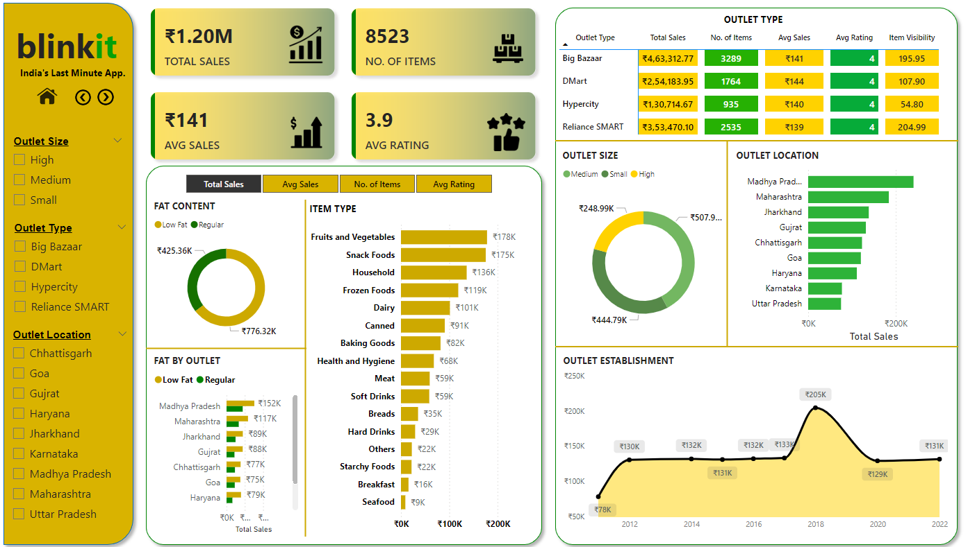
Performance Analysis

Slide 8
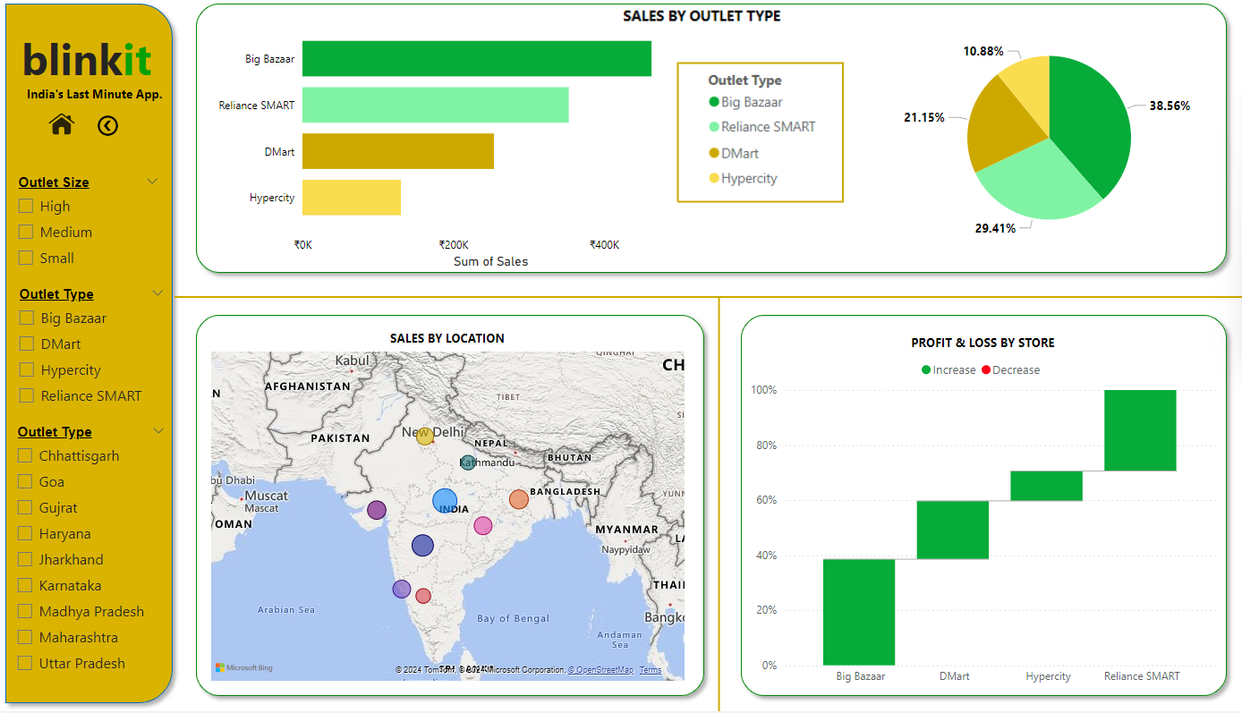

Slide 9
Performance Analysis
Total Sales by Fat Content : Objective: Analyze the impact of fat content on total sales. Additional KPI Metrics: Assess how other KPIs (Average Sales, Number of Items, Average Rating) vary with fat content.Chart Type: Donut Chart.
Total Sales by Item Type : Objective: Identify the performance of different item types in terms of total sales. Additional KPI Metrics: Assess how other KPIs (Average Sales, Number of Items, Average Rating) vary with fat content.Chart Type: Bar Chart.
Fat Content by Outlet for Total Sales : Objective: Compare total sales across different outlets segmented by fat content. Additional KPI Metrics: Assess how other KPIs (Average Sales, Number of Items, Average Rating) vary with fat content.Chart Type: Stacked Column Chart.

Slide 10
Total Sales by Outlet Establishment: Objective: Evaluate how the age or type of outlet establishment influences total sales. Chart Type: Line Chart.
Sales by Outlet Size:Objective: Analyze the correlation between outlet size and total sales.Chart Type: Donut/ Pie Chart.
Sales by Outlet Location:Objective: Assess the geographic distribution of sales across different locations.Chart Type: Funnel Map.
All Metrics by Outlet Type:Objective: Provide a comprehensive view of all key metrics (Total Sales, Average Sales, Number of Items, Average Rating) broken down by different outlet types.Chart Type: Matrix Card.

Slide 11
Real-Time Insights for Decision-Making
Provide a brief introduction to Blinkit, emphasizing its role as a leading online grocery delivery platform.
State the core objective of the analysis: to offer actionable insights into customer behavior, sales performance, and operational efficiency.
Highlight the role of real-time analytics in enabling data-driven decision-making for improved customer satisfaction and business performance.
Mention the use of Power BI as a dynamic tool for dashboard creation and analysis.

Slide 12
Conclusion and Future Scope
Summarize the key findings, emphasizing how the analysis provided actionable insights into customer behavior, sales trends, and operational efficiency.
Highlight the business benefits: enhanced customer satisfaction, improved delivery performance, and optimized inventory management.
Discuss potential future developments, such as expanding the dashboard’s capabilities with predictive analytics for demand forecasting or integrating additional data sources for deeper insights.
Reiterate the value of real-time analytics in driving continuous improvement and competitive advantage.

Slide 13
THANK YOU

